Slide 1

Design & Verification of an ALU using SystemVerilog & SVA
Abdelrahman Mohamed Yassien dir: /home/svgpdv25abohamad/alu_project

Slide 2
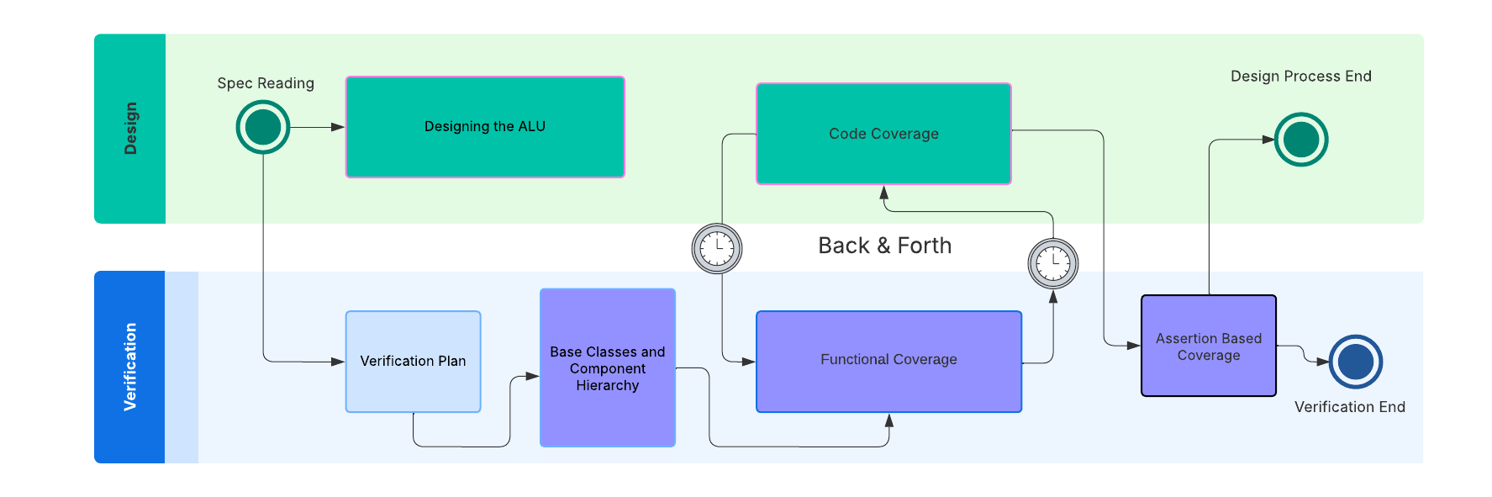
Project Timeline

Slide 3
Verification Plan
Plan | Description
Reset DUT | Resetting the DUT
ALU_en | Sending transactions while ALU_en is off
A_op Opcodes | Checking all A_op opcodes when (A_en & ~B_en)
B_11op Opcodes | Checking all B_op opcodes when (A_en & B_en)
Random Reset | Randomly Resetting the DUT during the entire simulation
Code Coverage | Ensuring all the DUT’s code lines were HIT using code coverage and making better test cases if not.
Functional Coverage | Ensuring all opcodes/values are met and tried using Functional Coverage and Fixing the DUT if not
Error Injection | Using an Error Injection scenario to check if the DUT hangs or behaves in a destructive way if faced with an undefined state or an out-of-bounds/unexpected inputs
Assertion Based Coverage | Asserting over the design specs, clock period, alu operations, alu_en, rst_n

Slide 4
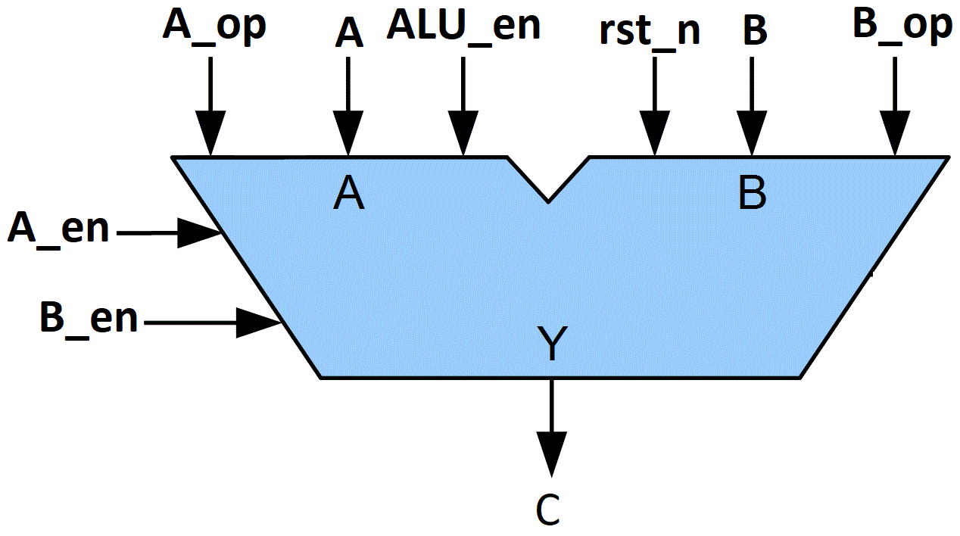
ALU DESIGN SPECIFICATIONS
(A_EN & ~B_EN) | A_op | C = ? | Description
 | 0 | A + B | Sum of inputs
 | 1 | A – B | B subtracted from A
 | 2 | A ^ B | A bitwise XOR B
 | 3 | A & B | A bitwise & B
 | 4 | A & B | A bitwise & B
 | 5 | A | B | A bitwise OR B
 | 6 | ~(A ^ B) | A XNOR B
 | 7 | NULL | Not permitted to take this value
(A_EN & B_EN) | B_op | C= ? | Description
 | 0 | A + B | Sum of inputs
 | 1 | A – B | B subtracted from A
 | 2 | A ^ B | A bitwise XOR B
 | 3 | A & B | A bitwise & B
(~A_EN & B_EN) | B_op | C = ? | Description
 | 0 | ~(A & B) | A NAND B
 | 1 | A + B | Sum of inputs
 | 2 | A + B | Sum of inputs
 | 3 | NULL | Not permitted to take this value

Slide 5
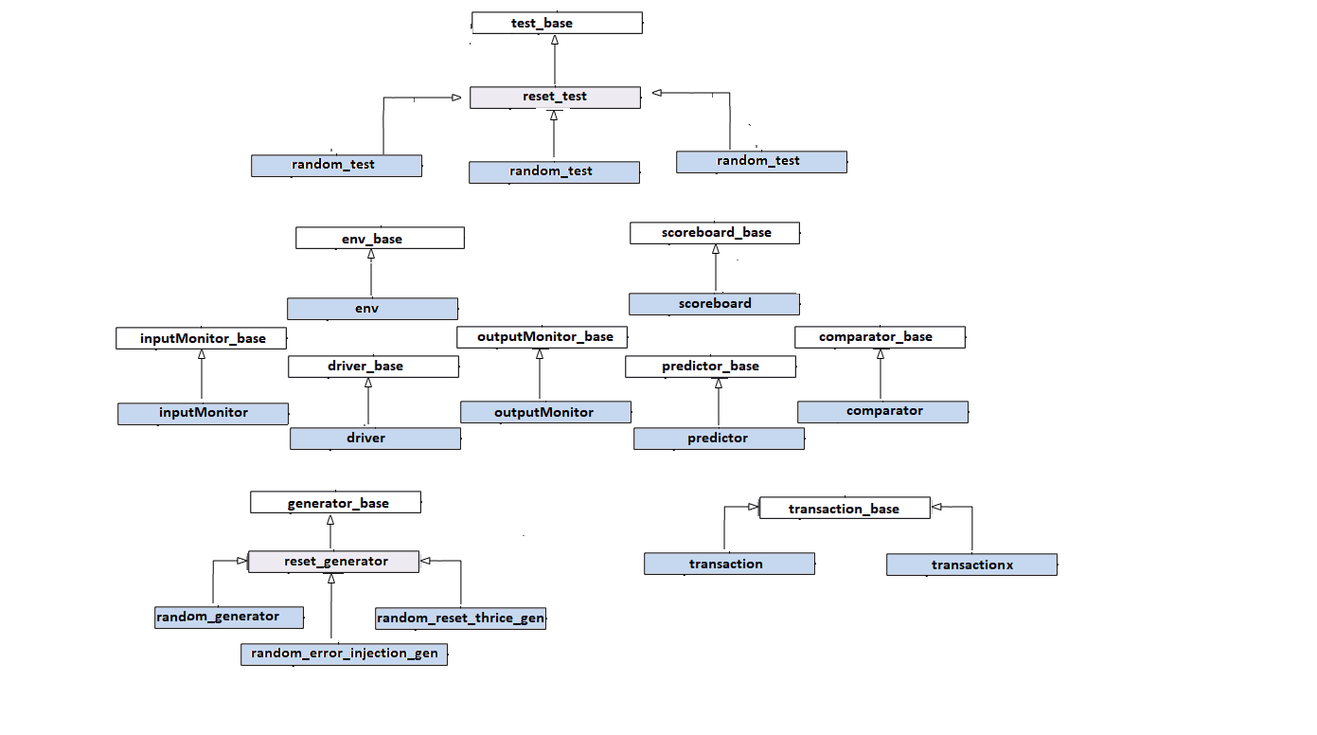
Verification Environment Classes

Slide 6
TOP ALU TESTBENCH
RANDOM TEST
RANDOM ERROR INJECTION TEST
RANDOM RESET THRICE TEST
GENERATOR
SCOREBOARD
DRIVER
INPUT MONITOR
OUTPUT MONITOR
Coverage Collector
Virtual Interface
Virtual Interface
Interface
Interface
DUT

Slide 7
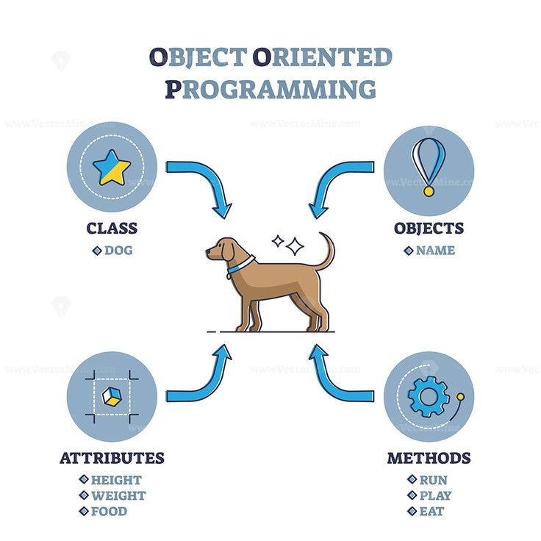
Classes? What do they do?

Slide 8
Driver & Driver Base
Driver_Base
Defines the mailboxes & Virtual Interface necessary for communication.
Pre-defines pure virtual execute task.
Driver
Constructs the parent using super.new();
Translates the transaction level items to pin level ones.
Sends the stimulus to the DUT.

Slide 9
outputMonitor & outputMonitor Base
outputMonitor_Base
Defines the mailboxes & Virtual Interface necessary for communication.
Pre-defines pure virtual execute task.
outputMonitor
Constructs the parent using super.new();
Samples the DUT outputs.
Translates the sampled outputs from pin level to transaction level.
Sends the sampled transaction level item to the Scoreboard/Comparator.

Slide 10
inputMonitor & inputMonitor Base
inputMonitor_Base
Defines the mailboxes & Virtual Interface necessary for communication.
Pre-defines pure virtual execute task
inputMonitor
Constructs the parent using super.new();
Sends the sampled inputs
Translates the sampled inputs from pin level to transaction level
Sends the sampled transaction level item to the Scoreboard/Predictor

Slide 11
Coverage & Coverage Base
Coverage_Base
Defines the mailboxes & Virtual Interface necessary for communication by the entire test structure
Pre-defines pure virtual execute task
Coverage
Constructs the parent using super.new();
Receives the input stimulus and sampled outputs from the input/outputMonitor and samples them through the coverage groups accordingly.

Slide 12
Scoreboard & Scoreboard Base
Scoreboard_Base
Defines the mailboxes & Virtual Interface necessary for communication between the predictor & comparator.
Pre-defines pure virtual execute task
Scoreboard
Constructs the parent using super.new();
Receives the input stimulus & the outputs of the DUT from both the InputMonitor & the OutputMonitor.
Is the bridge of communication between the predictor & comparator

Slide 13
Predictor & Predictor Base
Predictor_Base
Defines the mailboxes & Virtual Interface necessary for communication.
Pre-defines pure virtual execute task
Predictor
Constructs the parent using super.new();
Receives sampled input items from the scoreboard/inputMonitor and calculates the supposed expected output and sends it to the comparator through the scoreboard.

Slide 14
Comparator & Comparator Base
Comparator_Base
Defines the mailboxes & Virtual Interface necessary for communication.
Pre-defines pure virtual execute task
Comparator
Constructs the parent using super.new();
Receives sampled output items from the scoreboard/outpuMonitor and compares it to the previously sampled input items

Slide 15
Transaction & Transaction Base
Transaction_Base
Rand properties of the ALU, the inputs defined as rand.
Void Do_copy(); functions that copies all the fields and assigns it to another item
String functions for better debugging i.e. input2string, output2string, item2string
Transactionx
Constructs the parent using super.new();
Defining different constraints & transaction item number
Transaction
Constructs the parent using super.new();
Defining the needed constraints & transaction item number

Slide 16
Generator & Generator Base
Generator_Base
Defines the mailboxes & Virtual Interface necessary for communication.
Pre-defines pure virtual execute task
Reset_Generator
Generates a Reset Transaction
Constructs the parent using super.new();
Random_Reset_Thrice_Generator
Constructs the parent using super.new();
Randomly generates randomized items & 3 reset transactions every now and then
Random_Generator
Constructs the parent using super.new();
Generates randomized items
Random_Error_Injection_Generator
Constructs the parent using super.new();
Removes all the design spec constraints & drives randomized items

Slide 17
Comparator & Comparator Base
Comparator_Base
Defines the mailboxes & Virtual Interface necessary for communication.
Pre-defines pure virtual execute task
Comparator
Constructs the parent using super.new();
Receives sampled output items from the scoreboard/outpuMonitor and compares it to the previously sampled input items

Slide 18
Environment & Environment Base
Enviornment_Base
Defines the mailboxes & Virtual Interface necessary for communication by the entire test structure
Pre-defines pure virtual execute task
Environment
Constructs the parent using super.new();
Inestsantiates the entire testbench structure that is under the test.

Slide 19
Test & Test Base
Test_Base
Defines the mailboxes & Virtual Interface necessary for communication.
Pre-defines pure virtual execute task
Reset_Test
Constructs the parent using super.new();
Inestantiates the reset_generator and runs the item generated by it
Random_Reset_Thrice_test
Constructs the parent using super.new();
Inestantiates the random_reset_thrice_generator and runs the item generated by it
Random_test
Constructs the parent using super.new();
Inestantiates the random_generator and runs the item generated by it
Random_Error_Injection_test
Constructs the parent using super.new();
Inestantiates the random_error_injection_generator and runs the item generated by it

Slide 20
COVERAGE? What? For What?

Slide 21
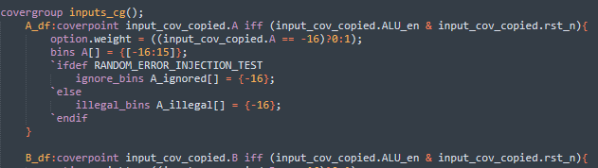
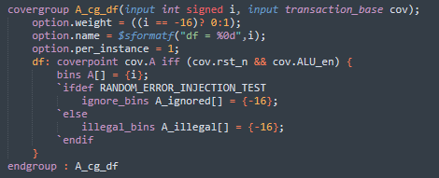

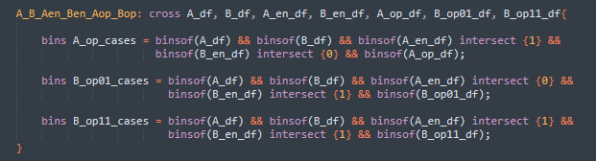
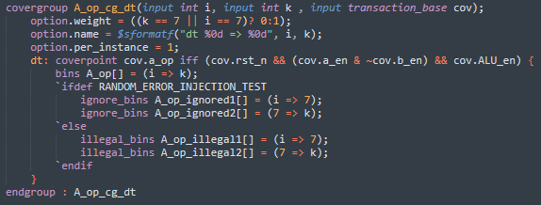


Coverage Examples
Fixed/Cross – based coverage
method
Instance – based coverage method
BODY
Construction
Sampling

Slide 22

Coverage Closure

Slide 23
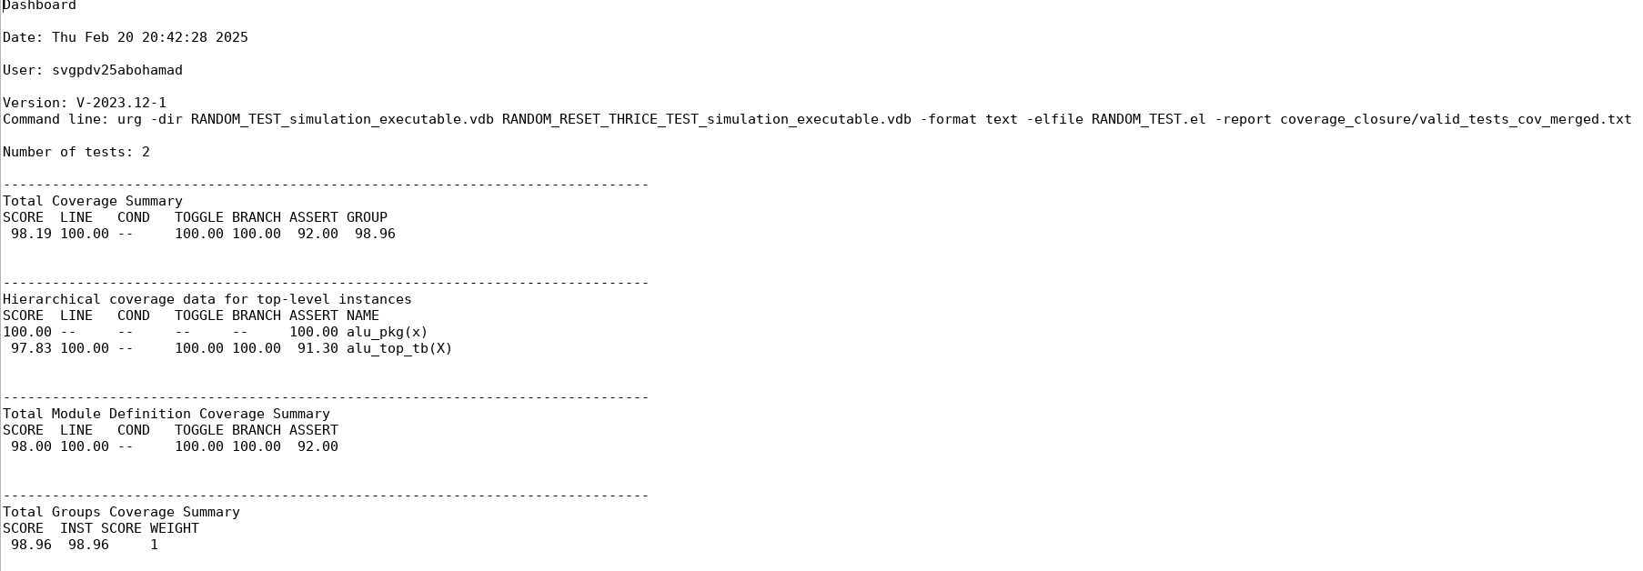
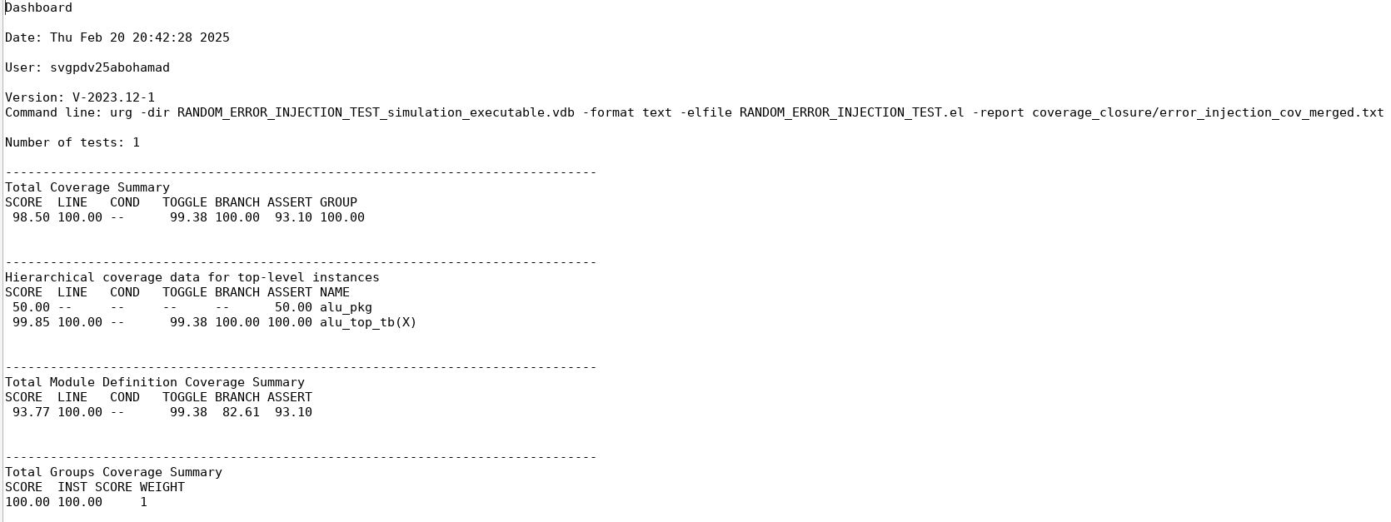
Dashboard.txt for valid Test
Dashboard.txt for Error Injection Test

Slide 24
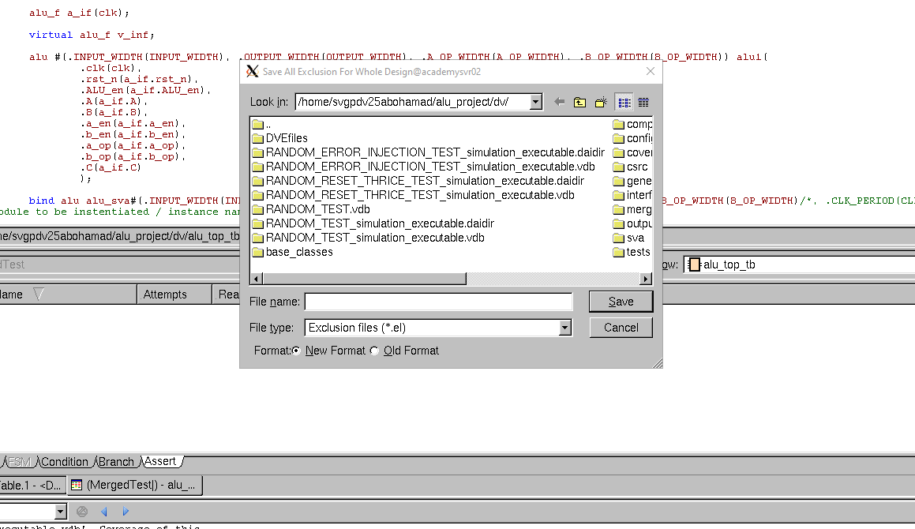
Exclusions and .el files
Exclusions can be done in the merge command line using –exclude but the naming of the branches, points, ..etc is often hard to make out and understand to just do it from the line, therefore using dve to make the .el file is much easier and thereafter including them in the report command.

Slide 25
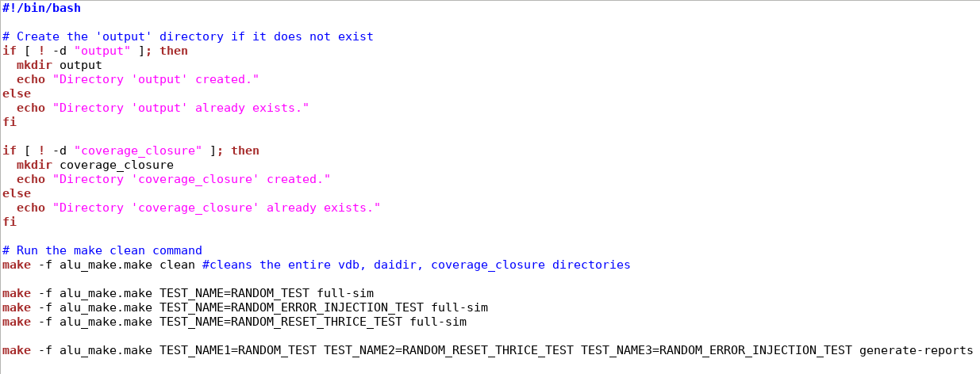
Scripting & Makefiles
A simple bash script to create ./output and ./coverage_closure directories, as well as running the make file

Slide 26
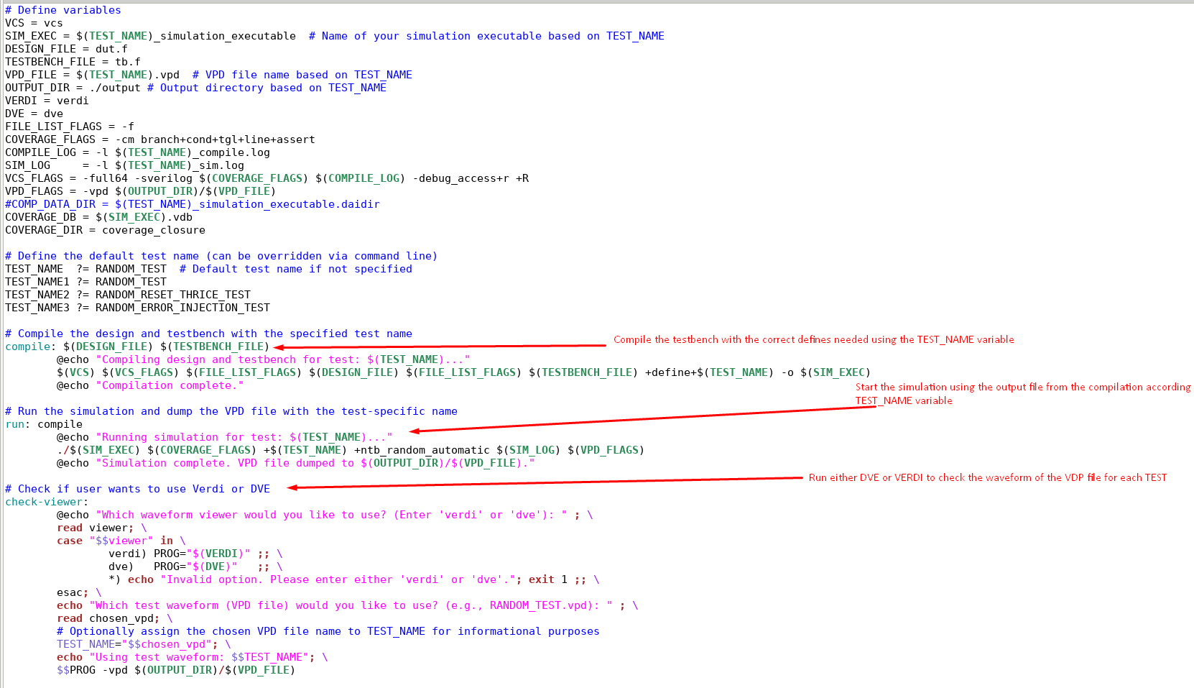
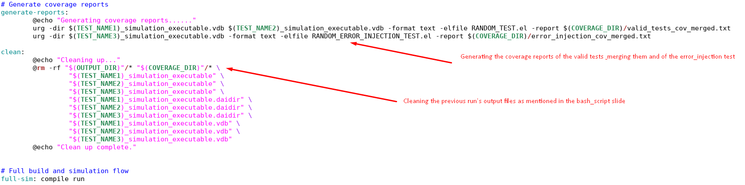
Scripting & Makefiles
Makefile to compile, run, check the simulation waveform using the .vdp files & clean each time the clean task is called or when the run_all.sh is executed
Saving compile and simulation.log files so they can be searched for any errors using a script if I have the time to make one

